Slide 1









Hanover and Tyke
COMPANY REVIEW
Presented by Olivia Wilson

Slide 2





Hanover and Tyke
ABOUT US
Our consultation service prioritizes client needs by offering personalized solutions after listening and understanding their unique requirements.
Our team is passionate about what we do, and we are committed to providing the best business advice.

Slide 3

Hanover and Tyke
CORE VALUES
Accountability
We take responsibility for our actions and results.
Excellence
We are dedicated to providing top-tier consultation services.
Integrity
We maintain high ethical standards.

Slide 4
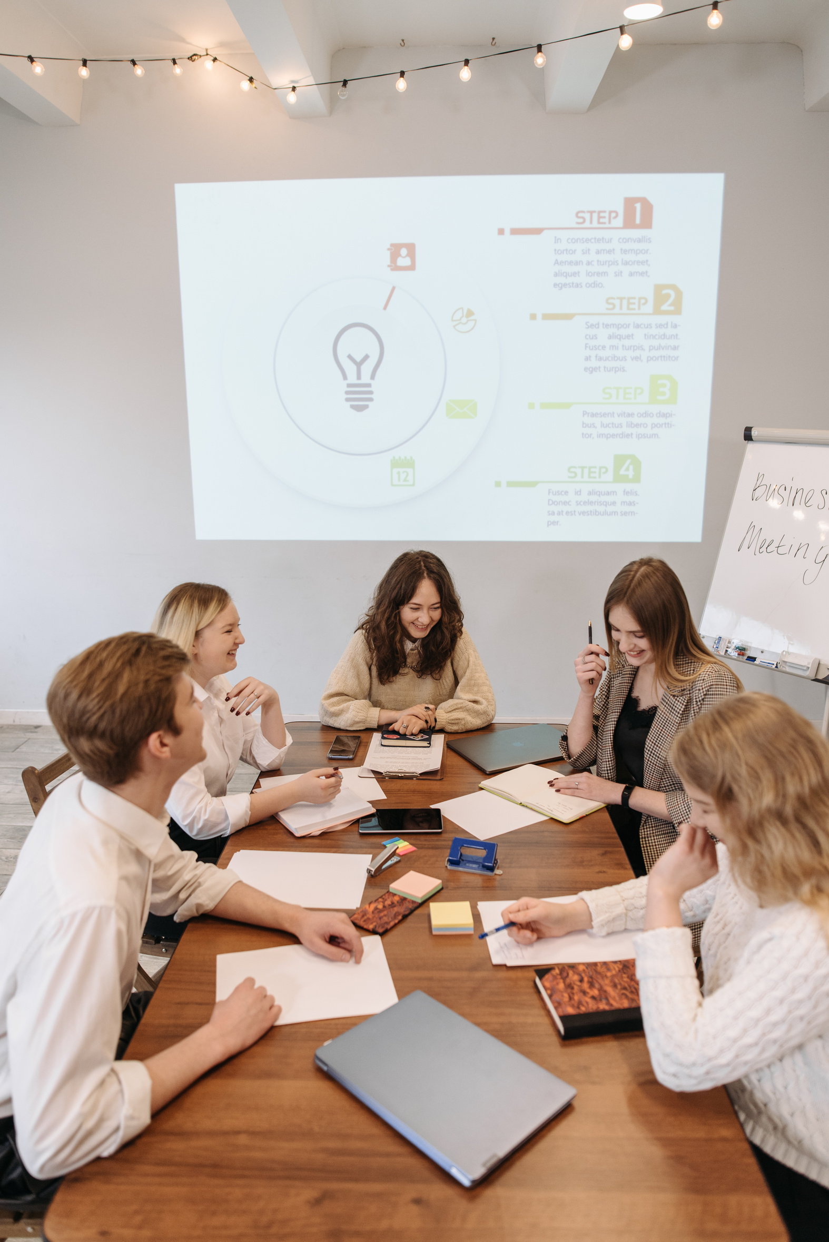

Hanover and Tyke
WHY US?
Our distinctive feature is our client-focused strategy. We place a high value on comprehending the specific requirements and obstacles of each client.
Discover the difference and experience excellence at Hanover and Tyke.

Slide 5




MISSION
Our mission is to empower organizations to thrive through strategic guidance, innovative solutions, and unparalleled expertise.
VISION
We aim to push boundaries using advanced tech for transformative solutions.

Slide 6



Hanover and Tyke
OUR SERVICES
We strive to provide top-notch service.

Slide 7
BUSINESS PROCESS OPTIMIZATION
We improve business processes for efficiency.
STRATEGIC PLANNING
ORGANIZATIONAL DEVELOPMENT
We work with clients to create strong strategic plans.
We assist organizations in developing high-performing teams.
FINANCIAL MANAGEMENT
We assist clients in improving their financial performance.

Slide 8
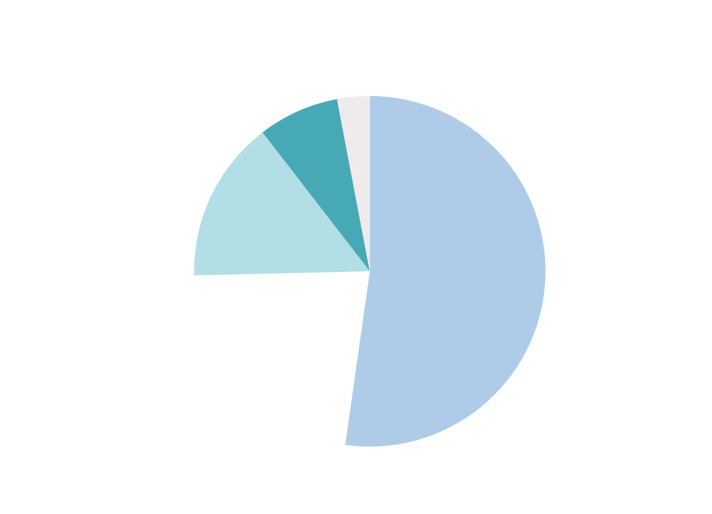


This pie chart illustrates the distribution of services availed by our clients for the past year.

Slide 9


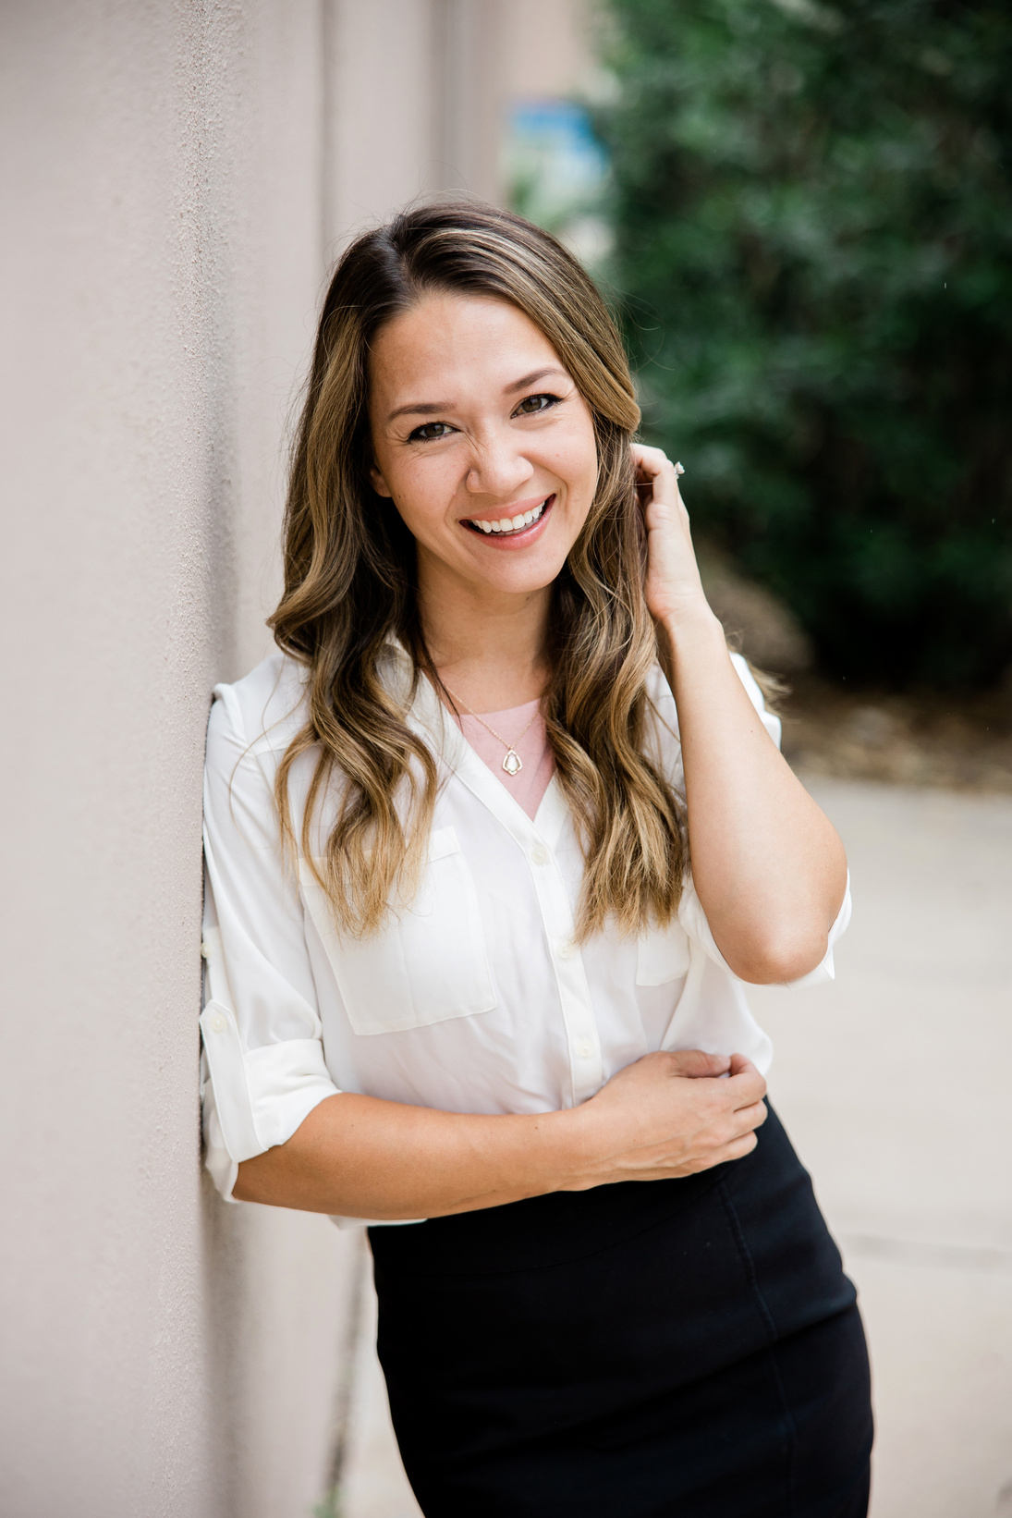
MEET THE TEAM
Hannah Morales
Olivia Wilson
Avery Davis
President
Head of HR
Head of Finance

Slide 10





WHEN CLIENTS CHOOSE OUR CONSULTATION SERVICE, THEY ARE PARTNERING WITH A TRUSTED ADVISOR.
Hannah Morales
President

Slide 11


CONTACT US
123 Anywhere St., Any City
123-456-7890
www.reallygreatsite.com
hello@reallygreatsite.com

